Slide 1
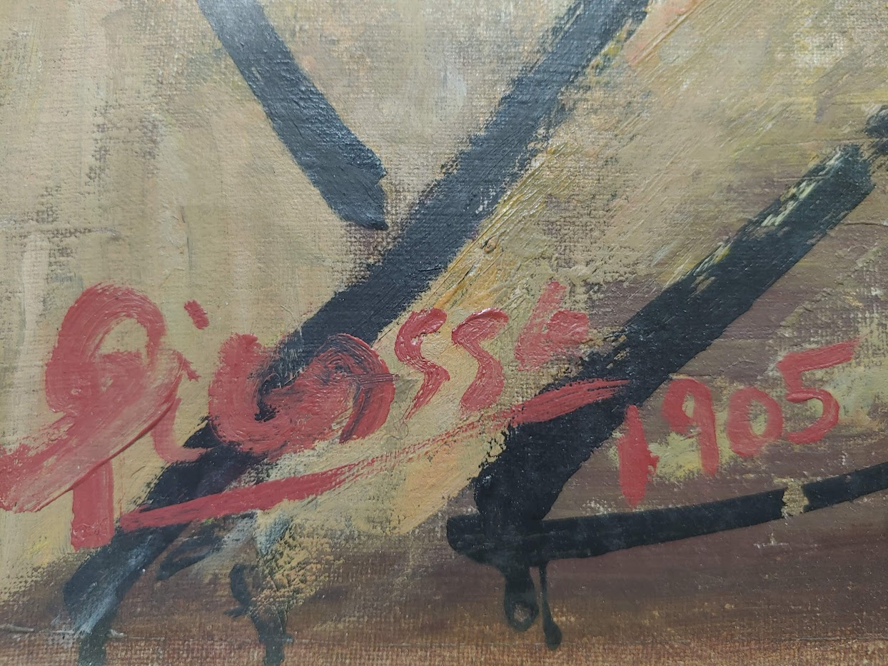
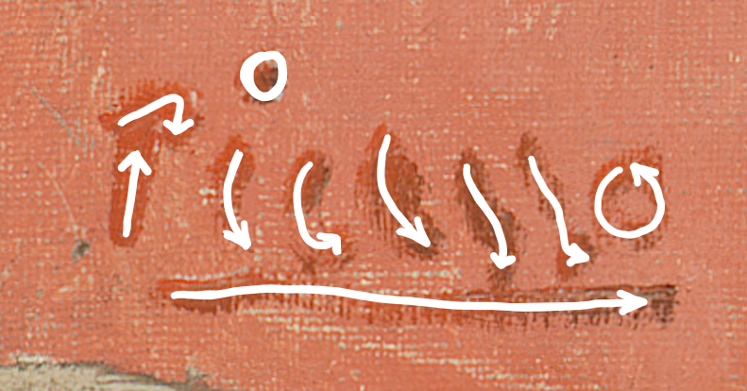


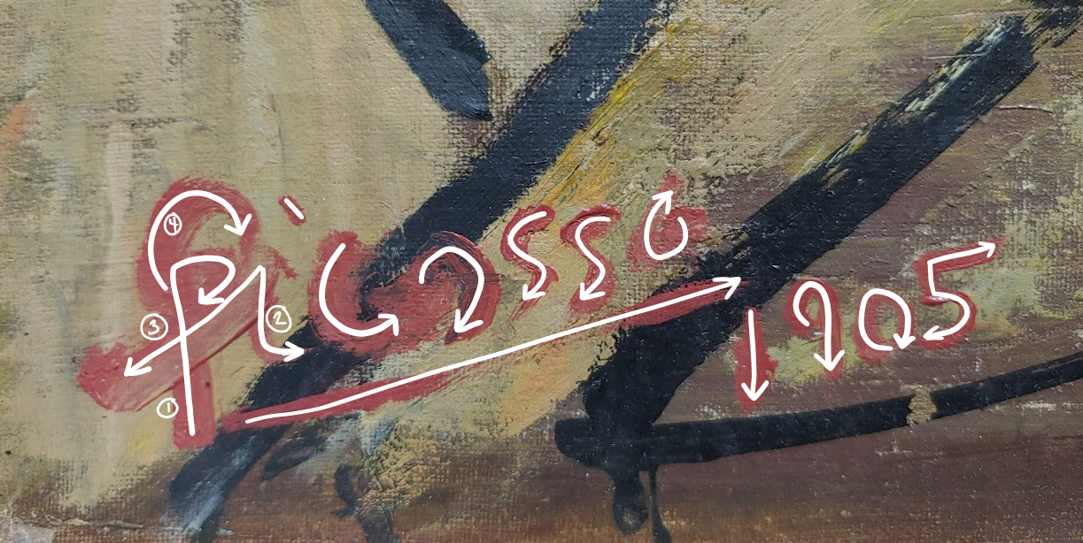
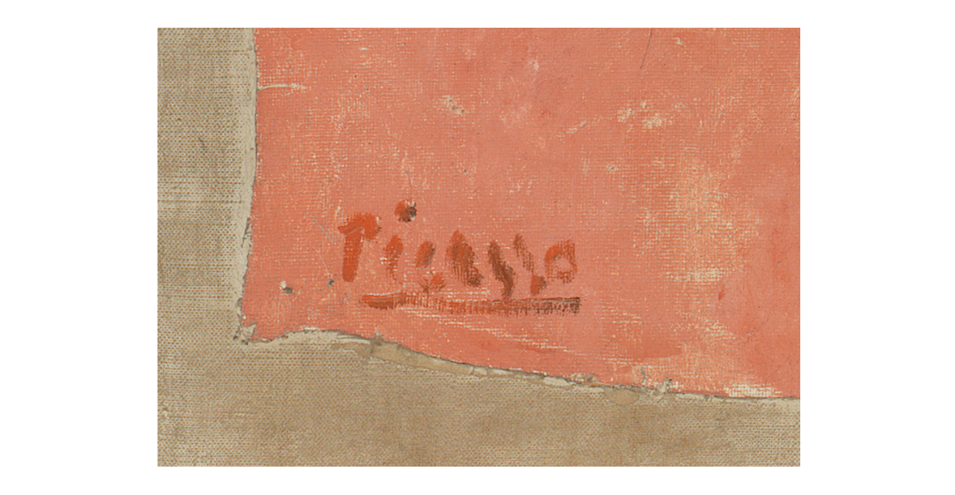
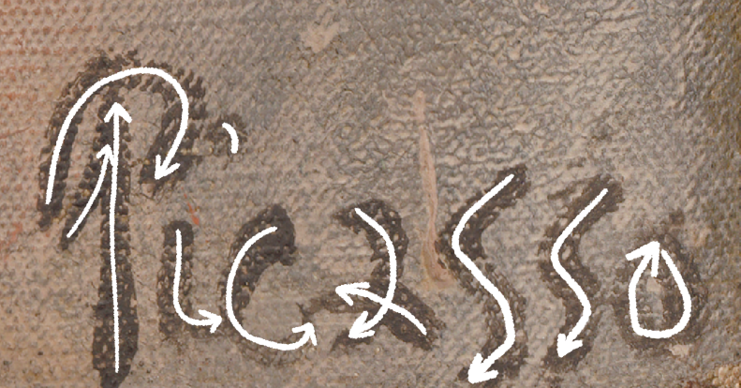
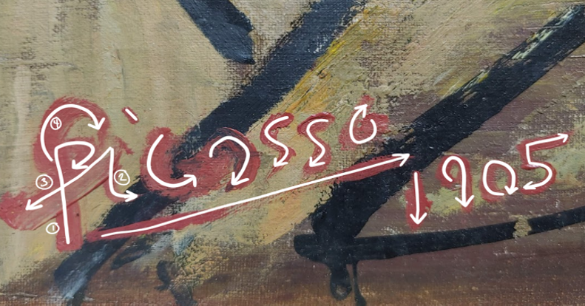
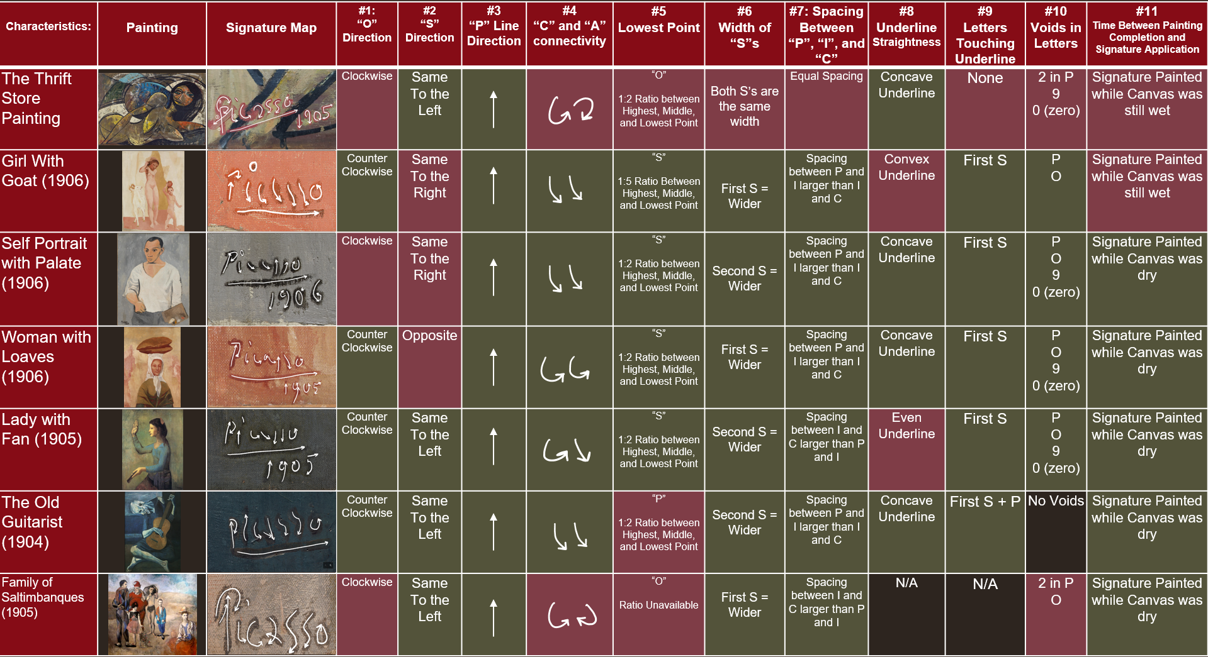
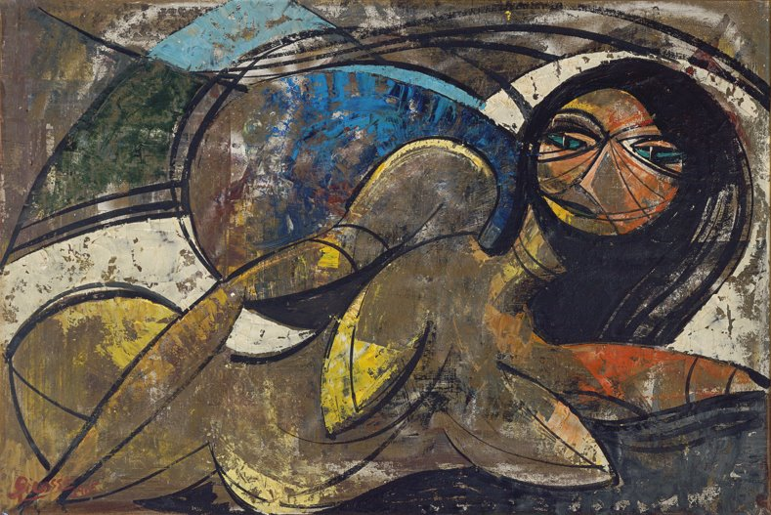

Phenomenon 1: (See figure 5). Almost all the letters move start at the top and move downwards and to the right. The 'o' is painted counterclockwise. This does not match phenomena observed in the subject work.
Phenomenon 2: The first 's' is the lowest point of the signature, and the signature does not appear to slant in either direction. This does not match phenomena observed in the subject work.
Phenomenon 3: The first 's' is marginally wider than the second 's'. This does not match phenomena observed in the subject work.
Phenomenon 4: The space between the "P" and the 'i' was significantly larger than the space between the 'i' and the 'c'. This does not match phenomena observed in the subject work.
Phenomenon 5: The underline jumps across the center in both directions. Both the 'c' and the first 's' touch the underline. This does not match phenomena observed in the subject work.
Phenomenon 6: There is negative space in the 'P' and the 'o'. This somewhat matches the phenomena observed in the subject artwork, however to note, the 'P' only has one area of negative space.
Phenomenon 7: None of the letters touch or overlap. This does not match phenomena observed in the subject work.
Other Phenomena: No other phenomena were noted during the examination.
The Potential Picasso (1905)
A Potential Picasso: A Forensic Signature Analysis between
Pablo Picasso and a Thrift Shop Find
Phenomenon 1: (See Figure 3). The first three letters flow towards the right, before changing directions during the 'a'. The 'asso' flows to the left of the canvas. The 'o' is painted clockwise.
Phenomenon 2: The 'P' had the lowest point in the signature, before slanting upwards during the rest of the signage.
Phenomenon 3: The two 's's were an even width
Phenomenon 4: The space between the 'P', 'i', and 'c' is even
Phenomenon 5: The underline is concave and does not touch any of the letters. The middle of the line is also incomplete.
Phenomenon 6: Negative space is located in the 'P' and 'o', as well as the 9 and 0. The 'P' has two different areas of negative space
Phenomenon 7: (See Figure 3) The 'P' overlaps the 'i'. The order of the strokes for 'P' and the 'i' are denoted in Figure 3 by the circled numbers in each stroke. On that note, see: Other Phenomena. The 'c' and 'a' are also connected. None of the numbers in the date are touching.
Other Phenomena: The underline is almost touching the 'P'. The Date is located under the signature. The 'P' has two different loops (a smaller one, and a larger one painted after the 'i')
Alina Hagen
The University of Tampa's Department of Art and Design | B.A. in Museum Studies
Abstract
Methodology
Graphological Results
Since the summer of 2019, Museum Studies and Chemistry students at the University of Tampa have collaborated on the "Potential Picasso Project," an interdisciplinary investigation of a "thrift shop" painting signed "Picasso 1905" in the lower left corner. This project installment utilizes art historical and forensic graphological resources to conduct a forensic analysis of the signature evidence to determine if attribution of the subject artwork can be made to Pablo Picasso according to his signature conventions from 1904 to 1906. The year 1905 is significant when conducting art historical research regarding Picasso, as it marks a shift from his stylistic "blue period" to "rose." Therefore, signed, authentic oil paintings painted by Picasso across both stylistic periods (during the years 1904, 1905, and 1906) have been selected to create a graphological profile of Pablo Picasso to compare against the subject artwork. Concurrently, a statistical analysis of a sample of Picasso's main body of work from these periods, pulled from a catalog raisonné, determined how often and where Picasso signed his work and how often he dated it.
Of the 51 signed oil paintings, six authentic signatures were used to build a graphological profile for Picasso using forensic signature analysis techniques. This study only selected oil mediums to avoid graphological differences based on mediums. The six works used are as follows:
Girl with a Goat (1906): The Barnes Foundation
Self Portrait with Palette (1906); Philadelphia Museum of Art
Woman with Loaves (1906); Philadelphia Museum of Art
Lady with a Fan (1905); The National Gallery of Art, DC
The Old Guitarist (1904): The Art Institute of Chicago
Family of Saltimbanques (1905); The National Gallery of Art, DC
Signature Mapping:
Each analysis began with creating a signature map, which involves examining the direction each letter was painted in and in what order the letters came into being, especially in the case of character overlap. This is achieved by utilizing high quality scans of the signature and enlarging them on a media viewer, where the ridges and individual brush stroke of the paint is visible. While people’s handwriting can evolve and change over time as they mature and their motor functions evolve, these changes usually occur over the course of several years. To avoid these handwriting discrepancies due to this fact, only signatures from 1904 and 1906 have been selected.
Individual Characteristics:
Following the signature mapping, each signature has been evaluated based on the following graphological characteristics.
The direction of the “O”
The direction of the “S”s
The direction of the “P” line
How the “C” and “A” flow and are connected
The lowest point in the signature
The width of the two “S”s
Spacing between the “P”, “I”, and “C”
Underline Convexity or Concavity
Letters touching the signature underline
Voids in closed letters (“P”, ”A”, “O”)
Time between painting completion and signature application
Performing the graphological examination resulted in the completion of the first goal of this investigation, which was to create a graphological profile for Picasso’s oil on canvas mediums from 1904 -1906 to be used as a comparative tool against the Thrift Store painting.
After removing Family of Saltimbanques (1905) from the graphological profile due to it’s position as an outlier (See: Family of Saltimbanques (1905) & The Thrift Store Painting (ca. 1905)), the Thrift Store painting only matched three out of eleven observed characteristics seen in the graphological profile. In some cases the Thrift Store painting goes directly against what was observed in the authentic signatures, such as in characteristic 4, where in the Thrift Shop painting the “C” and the “A” form almost a ying-yang shape and circle around each other, while in the authentic signatures the “C” and the “A” all started from the top and flowed to the right.
Even in cases where the observed characteristic is less than consistent, such as characteristics 6 and 7, the Thrift Store painting still manages to distinguish itself as something different from the graphological profile. In characteristics 6 and 7, all of the authentic signatures had uneven spacing and letter width; meanwhile, in the Thrift Shop Painting, both characteristics are perfectly even, implying that the action was calculated.
Background
Family of Saltimbanques (1905) & The Thrift Store Painting (ca. 1905)
Figure 4: A close-up of the signature found on Girl with a Goat (1906)
Figure 5: A close-up of the signature found on Girl with a Goat (1906) with the signature mapping overlaid on top of it
Graphology is an observational scientific study involving the analysis and categorization of handwriting characteristics to prove authorship. Today, it is used as a legitimate form of forensic evidence for various legal, civil, and criminal cases, such as verifying questionable artworks. While forensic graphology alone cannot confirm nor deny if Picasso painted the subject artwork, it can confirm several other things that can aid in attribution confirmation when paired with other historical, chemical, or stylistic pieces of evidence.
In 2017, a Chilean art investigation company, Veritart, conducted a similar graphological analysis of Picasso, which helped establish the skeleton structure for the methodology of this study.
During the Fall 2022 semester, this study used a catalog raisonné to compile and categorize 333 authenticated works based on year, medium, and whether they were signed. For Picasso's Oil Paintings (N=68), the statistical analysis determined that Picasso dated his work 75% of the time (VR= 0.25). Of his signed works (N =51), he most frequently (29.4%) signed them in the bottom right corner (VR= 0.71), dated them only 16% of the time (VR= 0.84), and underlined them 47% of the time (VR= 0.53). This quantitative analysis established a statistical foundation and class characteristics for the graphological profile and isolated 51 signed oil paintings as potential subjects for further graphological examination.
Graphological Examination
Figure 2: (Top) A close-up of the signature found on the subject artwork.
Figure 3: (Bottom) A close-up of the signature found on the subject artwork with the signature mapping overlaid on top of it.
Figure 3 (Left): A close-up of the signature found on Family of Saltimbanques (1905) with the signature traced in white. Photo: Institution. Mapping: Author.
Figure 4 (Right): A close-up of the signature found on the subject artwork with the signature traced in white. Credit: Author
During the signature mapping process, the first five out of the six authentic signature evaluations were relatively consistent, or at the very least, unsurprising in nature. When the final signature evaluation for Family of Saltimbanques (1905) was conducted, there was no question that it was an authentic signature, but when compared against the other evaluations it was noticeably an outlier.
What was surprising is the similarities shared between the Family and Thrift Shop painting, matching six out of nine relevant characteristics (because of Family’s lack of underline, characteristic 8 and 9 have been excluded). This is a significant improvement from the greater graphological profile, where the Thrift Store painting only exhibited three of the eleven observed characteristics from the first 5 evaluations (See: Graphological results).
According to research from the National Gallery of Art, the holding institution for Family, this painting was created and redone multiple times over the course of 9 months from 1904 to 1905. This suggests that Picasso began this painting during his blue period, a time in Picasso’s life that was dominated by melancholy, and finished it during his rose period, where Picasso began to explore more regarding his relationships with other people, his stylistic choices, and drug use; implying that this painting was the product of Picasso’s mental and stylistic transition. Unfortunately, due to time restraints, this project was unable to explore this new development more thoroughly , however, further research could more closely examine similarities of the signatures found these two paintings.
The direct comparison between the disputable signature of the Potential Picasso and the authentic signature of Girl with a Goat revealed that the potential signature on the subject artwork does not match 6 of the 7 observed phenomenon identified in the graphological profile of Pablo Picasso. Preliminary conclusions of the graphological examination include: Picasso did not paint the signature and the artist who did paint it did not have an understanding of Picasso's graphological profile; Picasso did paint the signature, but not in a way that aligned with his graphological profile of the period; or Picasso did paint the signature, but not during this period, meaning the signature might be misdated.
Figure 2: Chart visualizing how each authentic signature and the Thrift Shop painting embodied each individual characteristic identified during the signature mapping process. Text highlighted in green denotes a match of the characteristic, text highlighted in red denotes a discrepancy. Family of Saltimbanques (1905) is circled in red (See: Family of Saltimbanques (1905) & The Thrift Store Painting (ca. 1905)). Credit: Author
Conclusions
Acknowledgements
When weighing the previous findings of other project installments, class characteristics gained from the signature database, and the conclusions of the handwriting profile against the direct comparison between Family and the Thrift Store Painting, at this time this investigation cannot conclude beyond a reasonable doubt that the signature found on the Thrift Shop painting was painted by Picasso, leading to the conclusion that the Thrift Shop painting cannot be attributed to Picasso based on the signature evidence alone.
References
Thank you to OURI for providing the grant for our research, as well as to the Museum Studies program and the University of Tampa for providing this wonderful opportunity for research. A special thank you to the owner of the found painting for allowing us to conduct our research on their find and to Brooke Yost, a graduate student at USF, for assisting in the statistical analysis, as well as Dr. Rose Trentinella and Jocelyn Boigenzahn for their guidance throughout this project.
Arce, E. A.. "Calligraphic Analysis of the Signature Rubric Attributed to Pablo Ruiz Picasso." Tesoros de Picasso: Veritart. 2017. http://tesorosdepicasso.com/en/calligraphic-analysis-dub/
Daix, P., & Boudaille, G., Picasso: The Blue and Rose Periods (A Catalog Raissonne, 1900 – 1906), trans. Phoebe Pool. (London: Evelyn, Adams & Mackay, 1967).
Mishra A.. Forensic Graphology: Assessment of Personality. Forensic Research & Criminology International Journal 4, no 1:9-12. (January, 2017) DOI: 10.15406/frcij.2017.04.00097
Srihari, S. N., Cha, S., Aora, H., & Lee, S.. "Individuality of Handwriting". Journal of Forensic Science 47, no. 4 (July 2002). https://cedar.buffalo.edu/nij/documents/nij_ref.pdf
Picasso, P. Girl with a Goat. Oil on canvas, 1906, (The Barnes Foundation, PA), https://collection.barnesfoundation.org/
objects/5452/Girl-with-a-Goat-(La-Jeune-fille-a-la-chevre)/
Figure 1: Photograph of the subject artwork, signed 'Picasso 1905' in the bottom left-hand corner in red paint. Photo Credit: Jocelyn Boigenzahn
Scan for Works Cited

